Slide 1
RADV Risk Adjustment Data Validation Tool
FHIRed UP
Augusto Burgos aburgos3@gatech.edu Spiro Ganas spiroganas@gmail.com Anja Guillory anjag1993@gmail.com Jamie Richgels jrichgels3@gatech.edu Daniel Stoneburner dstoneburner3@gatech.edu Tala Suidan tmsuidan@gatech.edu

Slide 2
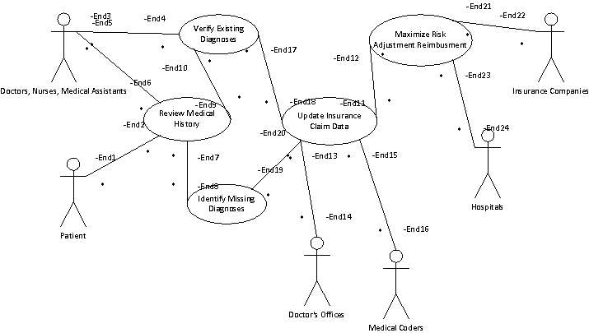
Use Case Diagram
Key Goals:
Verify diagnoses
Identify past conditions that need to be reviewed
Improve payments from the ACA risk adjustment process
Improve medical record data quality

Slide 3
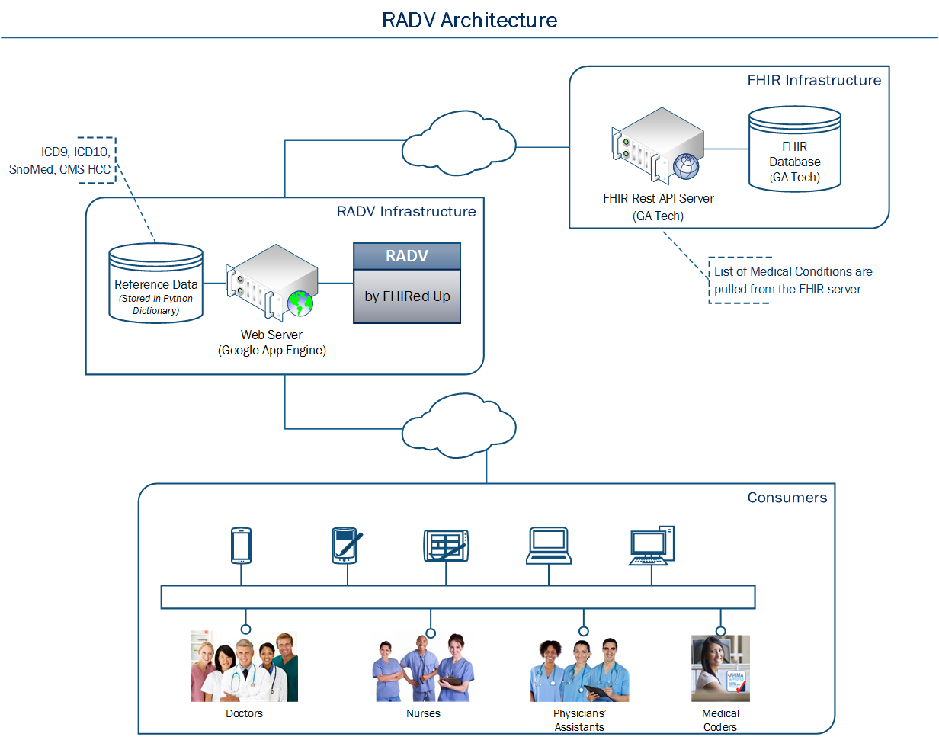
Architecture Diagram
Three-Tier Architecture
Data Tier
GaTech FHIR Server
Application Tier
Python Code
Presentation Tier
Google App Engine
HTML5
CSS
Javascript

